Slide 1

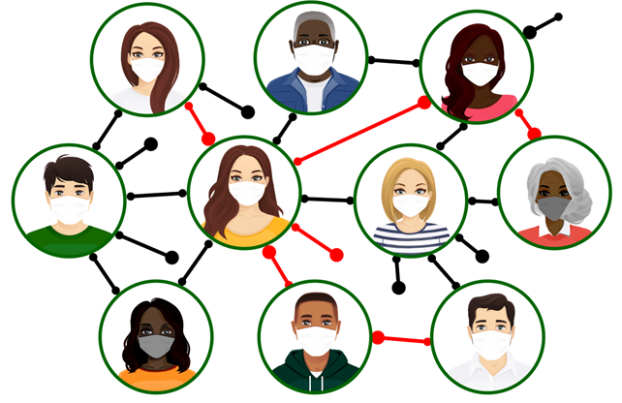

z
PROJECT 2
Global Covid-19 Trends
Team Members:
Megan Greenhill
Mike Murphy
Jacqueline Xia
Hesh Kuruppuge

Slide 2
z
Project Summary
The project uses a Python Flask-powered API to access an integrated PostgreSQL database that contains Covid-19 information sourced from the John Hopkins University Covid-19 time series datasets, vaccination information sourced from Our World in Data and population information sourced from Worldometers.
It provides the basis for an ongoing analysis of Covid_19 and its global impact using user selected visualisations.

Slide 3
Data Sources
z
JHU – Time Series Daily Reports : https://raw.githubusercontent.com/CSSEGISandData/COVID-19/master/csse_covid_19_data/csse_covid_19_time_series/time_series_covid19_confirmed_global.csv
World population data: https://www.worldometers.info/world-population/population-by-country/
Vaccination rates per country: https://ourworldindata.org/covid-vaccinations

